Slide 1


Capstone Project-1 (Exploratory Data Analysis)
Play Store App Review Analysis
https://colab.research.google.com/madhavimali
https://github.com/madhavimali/PlayStore
Notes:
Hello and welcome, my name is Madhavi Mali and today I will be presenting to you the result of Data Analytics Task.

Slide 2
Team Member
Team DATA DIGGERS
1. SARTHAK ARORA | sarthak1611@gmail.com
2. JAY NANDASANA | nandasanajay@gmail.com
3. MADHAVI MALI | madhvimali1996@gmail.com
4. PRANJALI TETE | pranjalitele@gmail.com
5. ARSHI WANI | arshiwani3@gmail.com
Notes:
Talking about Team Mates, we had a team of 5 people primarily focusing on this task.
Sarthak Arora is our Technical Architect and his expertise really helped to guide the team to produce high quality analysis.
Hello and welcome, my name is Madhavi Mali and today I will be presenting to you the result of Data Analytics Task.

Slide 3
Content
Introduction
Problem Statement
Dataset Description
Play store App Data
User Reviews Data
Data Processing Flowchart
Import Libraries
Data Loading
Null values Imputation / Data Cleaning
Data Segregation
Exploratory & Visualization Analysis
Conclusion
Notes:
In today’ presentation content will be follows:
1. Introduction about google play store app.
2. We will dive into the specific problem statement that we have, the our Data Analytic team have been focusing on it and will give some background as to why this is such a big problem.
3. Two different Dataset provided for analysis. First is Play Store App Data and second one is User Reviews Data.
4. Data processing Flowchart is all about the steps that I will follow high-level process to complete the task, so that you have complete clarity in how we tackle this kind of tasks.
5. Importing important libraries for future analysis.
6. Loading Data is mounting drive and reading csv file from google drive.
7. Null values Imputation / Data Cleaning is removing duplicates, Visual Impurities, Null values.
8. Segregate Numerical and Categorical Variable is useful to do process fast and easily plotting
9. I will go over all the important results and present them as a series of insights and visualizations from our analysis.
Finally conclusion which is the morel of the story.

Slide 4

Introduction
The Play Store apps data has enormous potential to dive app-making businesses to success. Actionable insights can be drawn for developers to work on and capture the Android market
Taking into account billion of Android users worldwide, mining this data has the potential to reveal user behaviours and trends in the whole global scope. This dataset is obtained from scraping Google Play Store.
Notes:
Mobile apps are everywhere.
The Play Store apps data has huge potential to dive app-making businesses to success. Actionable insights can be drawn for developers to work on and capture the Android market
Taking into account billion of Android users worldwide, mining this data has the potential to reveal user behaviours and trends in the whole global scope.
In this notebook, we will do a comprehensive analysis of the Android app market by comparing over ten thousand apps in Google play store across different categories.

Slide 5
Problem Statement
New app maker company is trying to identify various factors to capture android market ,so they are trying to find out the following things from the app store data:
1.Which is the best suitable Android version for new App?
2.Which are the top ‘category’ apps available in the play store?
3.What are the top ‘genre’ apps available in play store?
4.Ratings flow of the Apps
5.Paid and Free App ratio
6.People age group ratio, who are connected with play store
7.Apps vs their updated year ratio
8.Age group and its response against apps
9.Category wise free and paid apps
10.Age wise preferred category
Notes:
We have conducted an analysis of play store data to find insights of content.

Slide 6
Dataset Description Two different datasets provided for analysis: 1.Play Store Data.csv App : Categorical, the app name. Category : Categorical, category the app belongs to. Rating : Numerical, range from 0.0 to 5.0,Rating has received from the users. Reviews : Numerical, the number of reviews that the app received. Size : Numerical, the size of the app. The suffix M - megabytes, K - kilobytes. Installs : Numerical, describes the number of installs. Type : Categorical, a label that indicates whether the app is free or paid. Price : Numerical, the price value for the paid apps. Content Rating : Categorical, a categorical rating that indicates the age group for user. Genre : Categorical, list of genres to which the app belongs. Last Update : Date Format, the date at which the app was last updated. Current Version : Version of the app as specified by the developers. Android Version : The Android OS the app is compatible with.
Notes:
Alma Better provided two datasets for analysis.
First one is Play Store Data.csv : There are 13 features that describe a given app.
Second one is User review.csv

Slide 7
App : the app name. Translated_Review : the review text in English. Sentiment : the sentiment of the review, positive, neutral, or negative. Sentiment_Polarity : the sentiment in numerical form, ranging from -1.00 to 1.00. Sentiment_Subjectivity : a measure of the expression of opinions, evaluations, feelings, and speculations.
Dataset Description
2.User Reviews.csv
Notes:
User Reviews.csv contains 100 reviews for each app.
Clearly with such grand scale of data with such vast amounts of Rows and Columns comes with a lot challenges that makes this project more interesting.

Slide 8
Data Processing Flowchart
Import Libraries
DataFrame Loading
Drop Duplicate Entry
Remove Visual Impurities
Find Unique, Null Count and Data type
Data Filtering
Segregate
Numerical, Categorical
Data Visualization
Final Summery
Merge DataFrames for More data visualization
Notes:
Data Processing flowchart shows, how did we tackle the problem?
The key to success of any data project is to understand the data in detail. So, we import important libraries and load DataFrame for Data Understanding.
Data cleaning is one of the most essential subtask of any data science project. For that we drop duplicate entries, remove visual impurities like $, +, M, k from Price, Install and Size columns respectively.
We find unique values, Null count and datatype for Data Filtering purpose.
Segregation of numerical and categorical data for fast and easily ploting.
After extracting row data, we needed to process and model this data into a dataset that can precisely answer the business questions and produce analytics. With our new dataset, we used our analytical expertise to uncover insights from this dataset and to produce visualization to describe the insights.
We have two dataframe, so for more data visualization we merge both data.
Finally we write the summery of project.

Slide 9




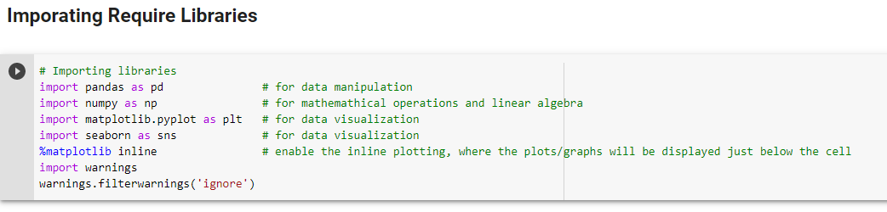
Import Libraries
library is a collection of related modules. It contains bundles of code that can be used repeatedly in different programs. It makes Python Programming simpler and convenient for the programmer.
Notes:
Importing important libraries:
Pandas for manipulation.
Numpy for mathematical operations and linear algebra
Matplotlib and Seaborn for data visualization.

Slide 10


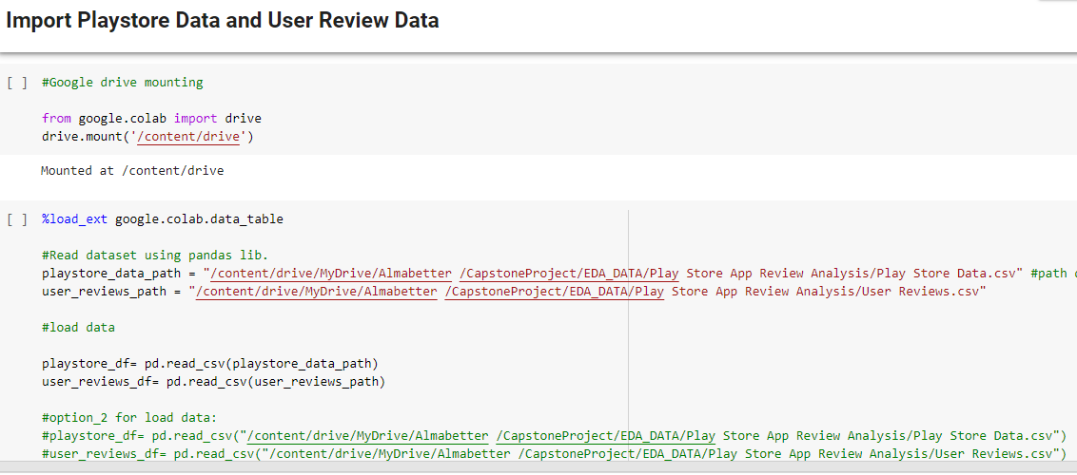
DataFrame Loading…….
1. Loading Google Drive For DATA
3. Data File Google Drive path
2. Interactive display of tabular data
4. Read dataframe using pandas library
5. 2nd method for load dataframe
Notes:
First of all I mount the google drive.
We load extension google.colab.data_table for interactive display of tabular data.
I provide google drive path for playstore_data.csv file and user_review_data.csv file.
And then read the dataframe using pandas library

Slide 11
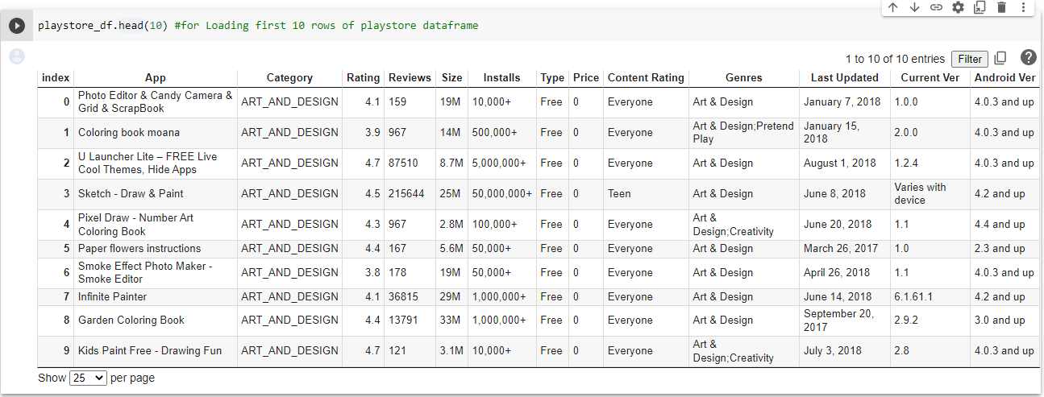
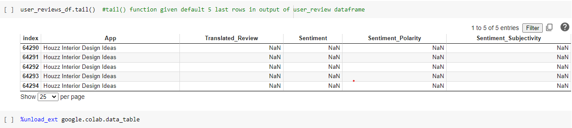
DataFrame Loading…….
1. The head () method returns a specified number of rows, string from the top
2. The tail () method returns a specified number of rows, string from the bottom. Default o/p 5 bottom rows
3. Unloading advance feature display of tabular data
Notes:
Here for loading data we use head() and tail() method

Slide 12
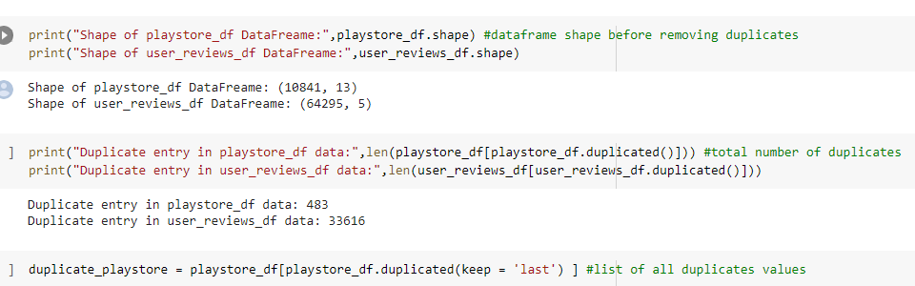
Drop Duplicate Entry
Duplicate Enter data is repeated data in dataframe,
Either multiple columns have same data or multiple rows have same data.
Repeated Entry add some number of data in final data and it miscalculates the true outcome.
df.duplicated() method is used to identify duplicates from dataframe
1. shape of data (Rows,Columns)
2. Identify duplicate entries
3. keep the last instance of a duplicate row in dataframe
Notes:
In our dtaframe some entries may be repeated. Repeated Entry add some number of data in final data and it miscalculates the true outcome.
So tne next step is to drop the duplicate entries.
Before droping the duplicate entries, number of rows in playstore dataframe are 10841and number of rows in user reviews dataframe are 64295.
Identified number of duplicate entries in playstore dataframe are 483 and in user reviews dataframe are 33616.
Store all duplicate entries in duplicate_playstore variable.

Slide 13
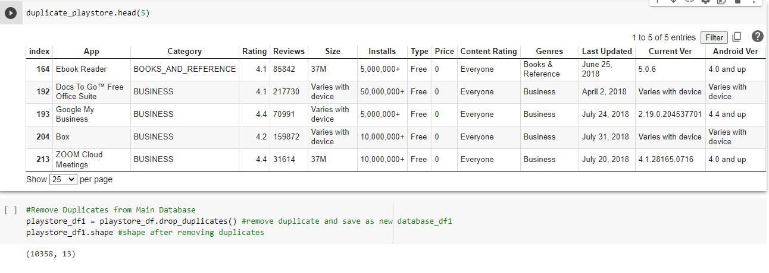
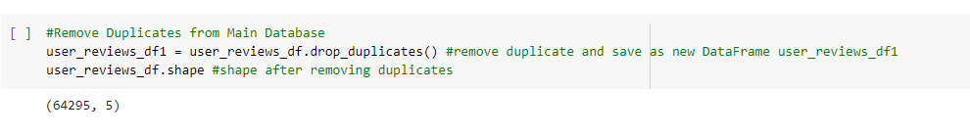
Drop Duplicate Entry
1. Print Duplicate Entry Data of playstore_df
2. Remove Duplicate Entry Data from playstore_df, print shape of data after removing duplicate entry
3. Remove Duplicate Entry Data from user_reviews_df, print shape of data after removing duplicate entry
Notes:
Print Duplicate Entry Data of playstore_df.
Now drop all the duplicates from both the dataframe for true outcome in future

Slide 14
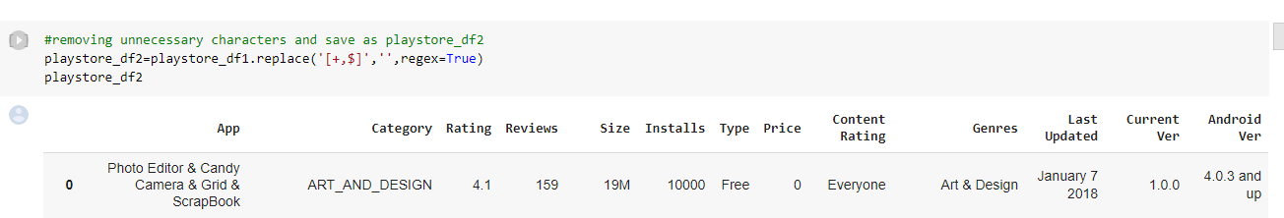
Remove Visual Impurities
Visual Impurities is like eye sight impurities in dataframe, without additional deep finding visible impurities
Like: Price Column have “$” sign and Installation column have “+” sign
1. Check dataframe and replace + and $ with blank so it works like delete.
Data after filter +
Data after filter $
Notes:
Visual Impurities is like eye sight impurities in dataframe. Like: Price Column have “$” sign and Installation column have “+” sign
So check dataframe and replace + and $ with blank so it works like delete.
Data after filter +, $ in Installs, Price column.

Slide 15
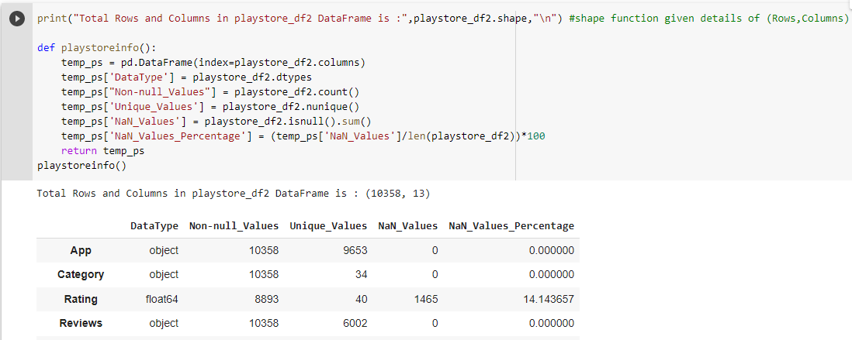
Find Unique, Null Count and Data type
For more cleaning of data we identified Unique data – Null Counts and Data type of each column
Unique Data - Unique value of particular column
Null Count - NULL means that there is no value
Nan Count - NaN mean that there is some value, although one that is perhaps not usable
Data type - Type of data like int, float64, object
Total value of App and Unique value are different, which means some App entries are repeated
Notes:
Here we can see the total values of App and unique values are different, which means some App entries are repleated.
Also we can see others columns have repeted entries.

Slide 16
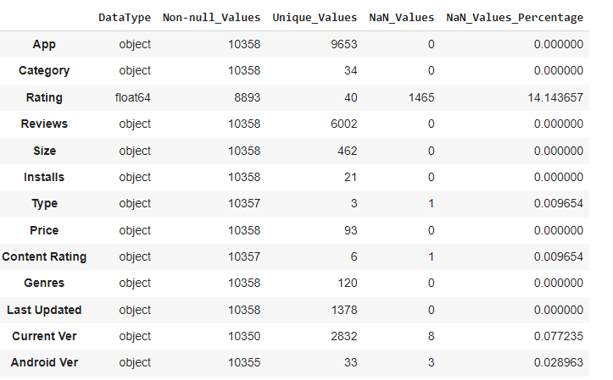
Information From Data Digging
Some columns have null values that need to be filled or filtered
Datatype are not correct for some columns like price , size, Installs and Last Update
Total count of each rows are not same so database are missing
Notes:
We get most important information from data digging.
1. Datatype are not correct for some columns like price , size, Installs and Last Update
2. Some columns have null values that need to be filled or filtered like rating, type content Rating, current ver, android ver.
3. Total count of each rows are not same so database are missing.

Slide 17
Data Filtering Column by Column
All Columns have some mistakes and unreliable things that need to be filtered
No | DataType | Mistakes and Unreliable things on specific Column
1 | App | Repeated Entry in app column indicated some repeated apps are there
2 | Category | 1.9 entry in category is outliner, checked data and shifted the row
3 | Rating | Null values present, filled it with mean() or median()
4 | Reviews | Data type mistake, it’s a numerical data type
5 | Size | Converted the size into one single unit
6 | Installs | After removing +, corrected the data type to numerical
7 | Type | 1 null value present, filled it with proper data (After Crosscheck with play store fill with "Free" )
8 | Price | After removing $ sign, need to correct data type to numerical
9 | Content Rating | Did not require any operation
10 | Genres | Did not require any operation
11 | Last Updated | Data type needed to replace to Date Format : datetime64[ns]
12 | Current Ver | Did not require any operation
13 | Android Ver | Did not require any operation
Notes:
All Columns have some mistakes and unreliable things that need to be filtered or filled.
Repeated Entry in app column indicated some repeated apps are there.
1.9 entry in category is outliner, checked data and shifted the row .
In rating column null values present, filled it with mean() or median().
Data type mistake for reviews, last updatae columns. So we have to correct it.
For size column : Converted the size into one single unit.
For installs column : After removing +, corrected the data type to numerical.
For type column : 1 null value present, filled it with proper data.
For price column : After removing $ sign, need to correct data type to numerical

Slide 18
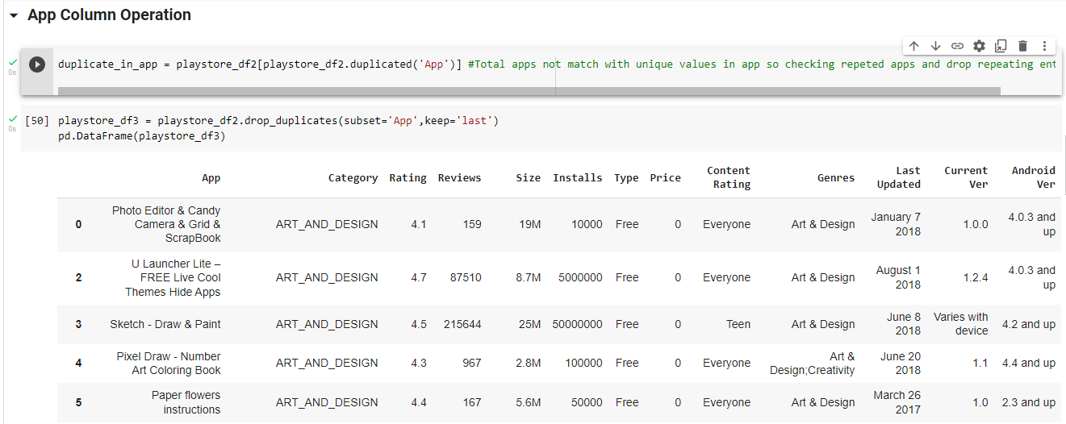
App Column Operation
1. Identify duplicate apps
2. Remove duplicates and clean data and store in playstore_df3 dataframe
Notes:
For App column:
First of all identify duplicate apps
Then remove the duplicate and clean the data
And store in playstore_df3 dataframe.

Slide 19
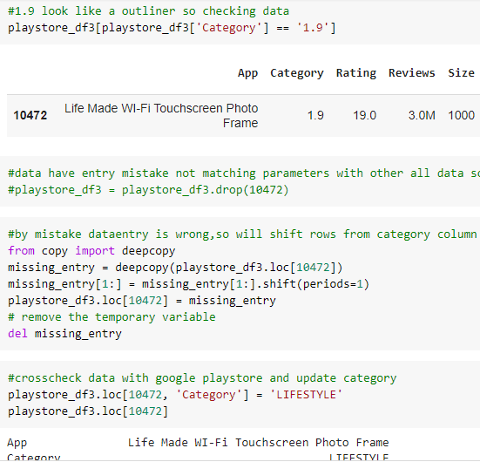
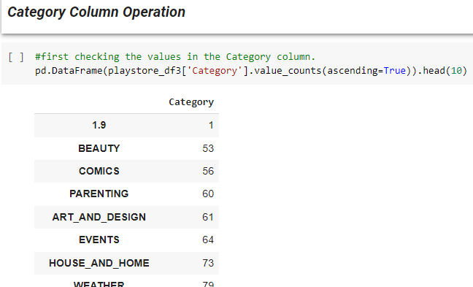
Category Column Operation
1.
2.
1.outliner
2. Find row of that data
3. Shift data
4. Replace with “LIFESTYLE” (check with playstore)
Notes:
For category column
1.9 is outliner in category column.
So we find row containing 1.9, and in this row we can see data entry for category column is missing so data is unnecessarily shifted towards left.
That’s why we shifted it toward right by adding missing value as ‘LIFESTYLE’.

Slide 20
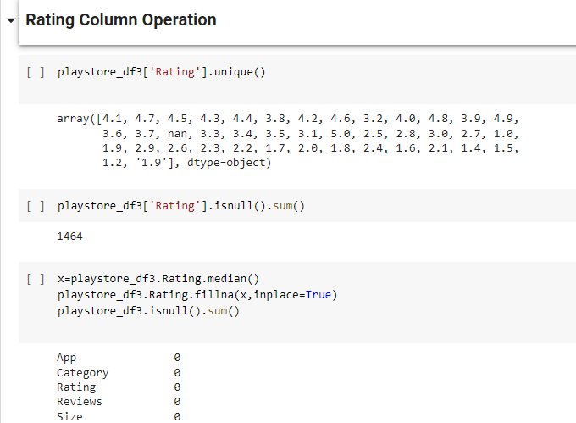
Rating Column Operation
1. Find Unique value
2. Count Null value
3. Fill with Median
Notes:
For rating column:
First we find all the unique values.
Here we can see there are null values in rating column. And the count of null values is 1464.
So we filled all the null values with median.

Slide 21
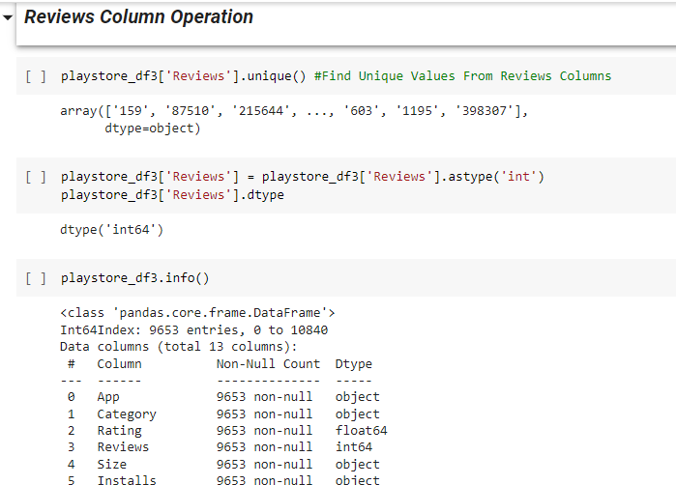
Review Column Operation
Find all the unique values.
convert data type to “int”
Notes:
For reviews column:
First we find out all the unique values.
Here we can see the data type is object. So we have to convert it into integer data type which is correct for this column.

Slide 22
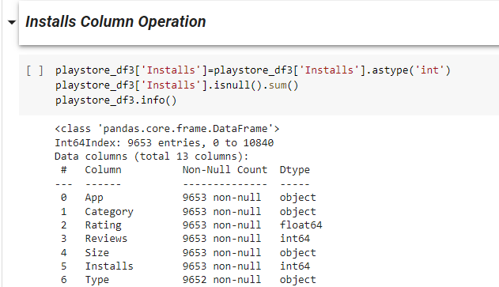
Installs Column Operation
convert data type to “int”
Here we can see it converted into “int” data type
Notes:
For installs column:
Installs column is of object type. So we have to convert it into integer data type which is correct data type for this column.

Slide 23
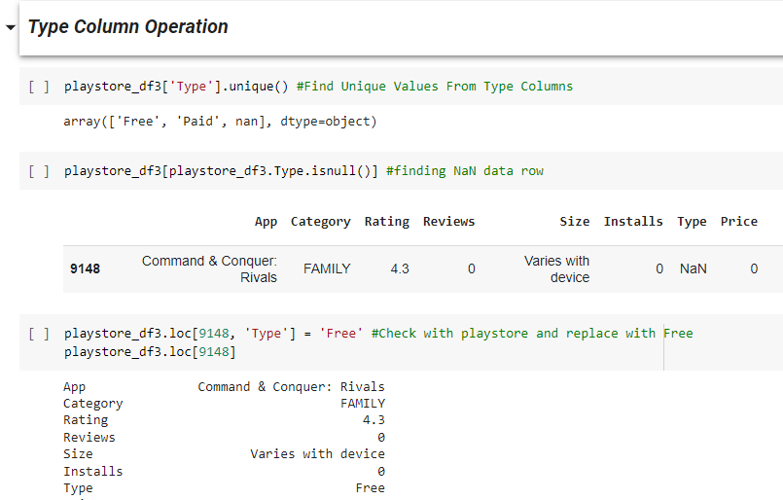
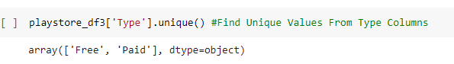
Type Column Operation
1. Find Unique values
2. Identify Row Number
3. Replace with “Free” (check with playstore)
4. Check unique values after replace value
Notes:
For type column:
First we will find all the unique values. Only three unique values are there which are Free, Paid and nan.
NaN is null value. So we find row containing null value. And replace it with Free.
So type column has only two types Free and Paid.

Slide 24
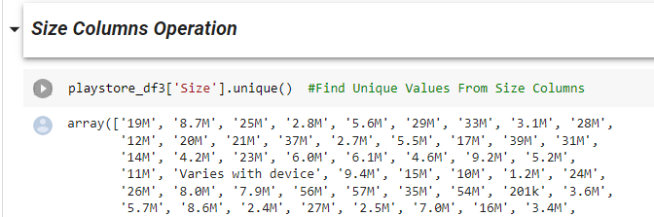
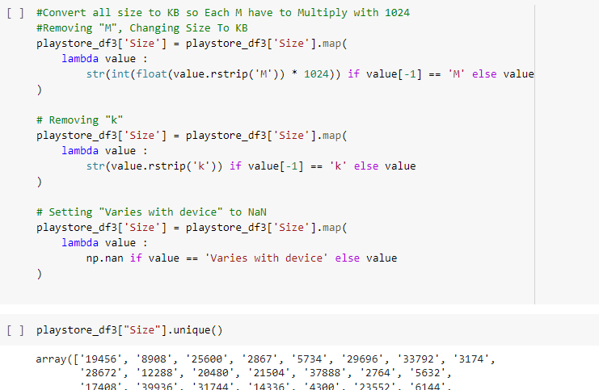
Size Column Operation
1. Value contain ‘M’, ’K’, Varies with device
2. Convert MB to KB and Remove K & M
3. Filter Data output
Notes:
For size column:
First we find all the unique values. And here we can see values contain ‘M’, ’K’, Varies with device.
We have to convert it into only one unit.
So we convert MB to KB. And remove visual impurities like ‘M’ and ‘K’.
And here we can see filter data output.

Slide 25
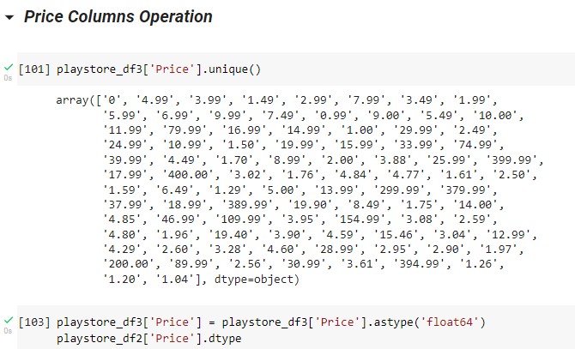
Price Column Operation
Find unique values
Data type is object
convert into “float”
Notes:
For price column:
First find out unique values.
Here we can see data type of price column is object.
So we convert it into float.

Slide 26
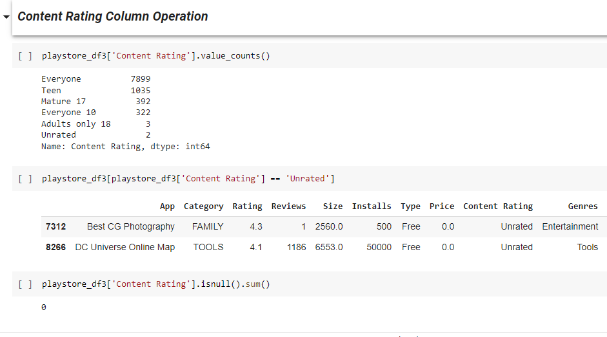
Content Rating Column Operation
1. Find value count of each type
2. Unrated apps also considerable for Everyone
Null value count is zero
Notes:
For content ratting column:
First find value count of each type.
There is no null value in content rating column.
Here we can see there are two unrated apps.
So we will consider unrated app for everyone

Slide 27
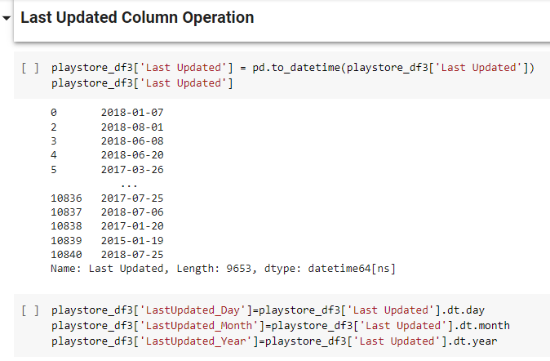
Last Update Column Operation
1.Converted to datetime datatype
2. Separate Month, Day, year and Store in new column
Notes:
For last update column:
Last update column is of object datatype.
So we convert it to datetime datatype which is correct datatype for this column.
For more specifications we separate month, day and year and store it in new column.

Slide 28
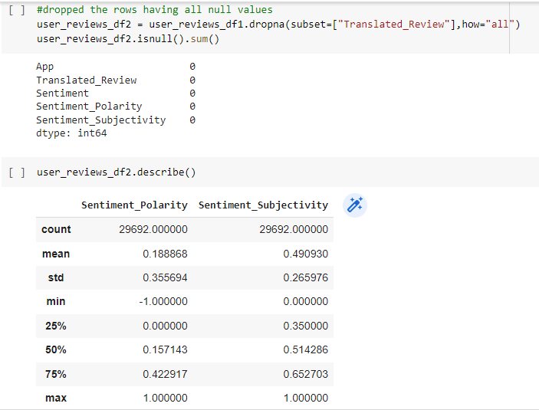






User Reviews DataFrame Operation
1. Unreviewed Columns Dropped
Sentiment_Subjectivity is Between 0 to 1
Sentiment_Polarity is Between -1 to 1
Notes:
For user reviews dataframe:
Drop all rows having null values.
Describing numerical data:
Sentiment_Subjectivity is Between 0 to 1.
Sentiment_Polarity is Between -1 to 1

Slide 29
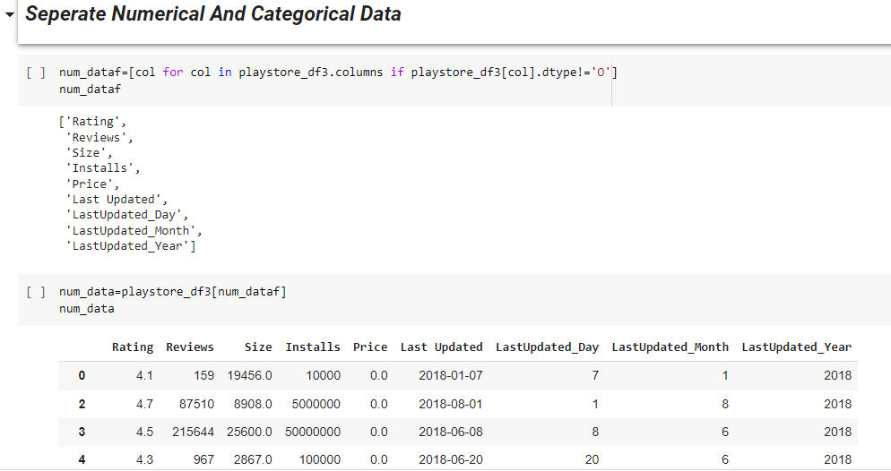
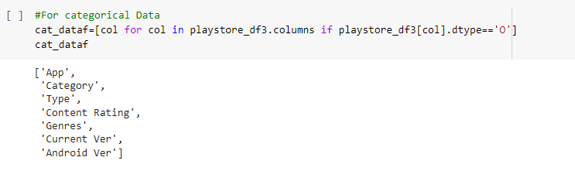
Segregate : Numerical, Categorical Variable Data
Segregate Numerical and Categorical Variable is useful to do process fast and easily plotting
1. Dtype is not an object it’s a numerical data
3. Dtype is equal to object then it’s a categorical data
2. Output of numerical data
Notes:
Segregate Numerical and Categorical Variable is useful to do process fast and easily plotting
Rating, reviews, size, installs, price, last update, last update day, last update month, last update year is numerical data.
Apps, categary, type, content rating, genres, current ver, android ver is categorical data.

Slide 30
Data Visualization
Correlations in Relationships: Without data visualization, it is challenging to identify the correlations between the relationship of independent variables. By making sense of those independent variables, we can make better business decisions.
Trends Over Time: While this seems like an obvious use of data visualization, it is also one of the most valuable applications. It’s impossible to make predictions without having the necessary information from the past and present. Trends over time tell us where we were and where we can potentially go.
Frequency: Closely related to trends over time is frequency. By examining the rate, or how often, customers purchase and when they buy gives us a better feel for how potential new customers might act and react to different marketing and customer acquisition strategies.
Examining the Market: Data visualization takes the information from different markets to give you insights into which audiences to focus your attention on and which ones to stay away from. We get a clearer picture of the opportunities within those markets by displaying this data on various charts and graphs.
Risk and Reward: Looking at value and risk metrics requires expertise because, without data visualization, we must interpret complicated spreadsheets and numbers. Once information is visualized, we can then pinpoint areas that may or may not require action.
Reacting to the Market: The ability to obtain information quickly and easily with data displayed clearly on a functional dashboard allows businesses to act and respond to findings swiftly and helps to avoid making mistakes.
Notes:
Data Visualization is important for
Correlations in relationship means to identify the correlations between the relationship of independent variables.
Trend over time is impossible to make predictions without having the necessary information from the past and present.
Frequency is used to examining the rate, or how often, customers purchase and when they buy gives us a better feel for how potential new customers
Examine the market is nothing but which audiences to focus your attention on and which ones to stay away from.
Risk and rewards is without data visualization, we must interpret complicated spreadsheets and numbers.
Reacting to the market is the ability to obtain information quickly and easily with data displayed clearly on a functional dashboard allows businesses to act and respond to findings swiftly.

Slide 31
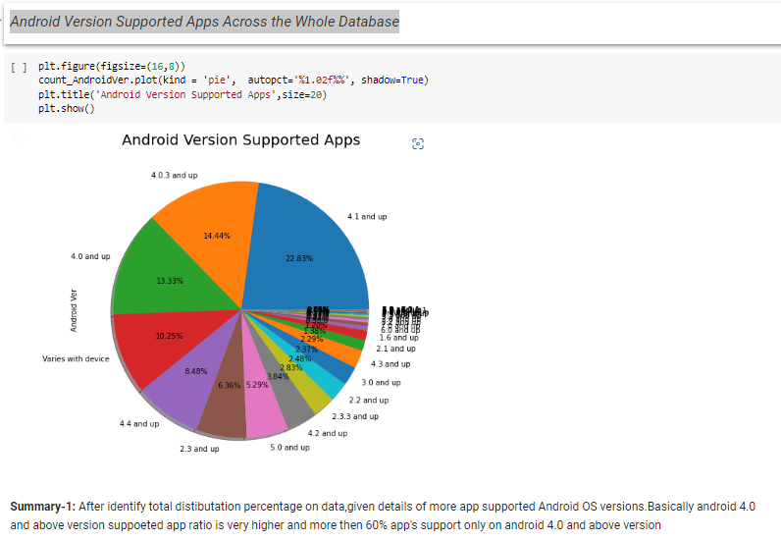
1. Most Android Ver. Supported Apps in Play store
Helpful to develop apps and minimum criteria
Find out outdate versions of apps
Identify detail about new trend version contribution
Notes:
Now we'll get into the fun part. We will try different visualization techniques to understand the life all characters.
From pie chart we can say, android 4.0 and above versions supported app ratio is very higher and more than 60% apps support on;y on 4.0 and avove versions.
This pie chart is 1. Helpful to develop apps and minimum criteria
2. Find out outdate versions of apps
3. Identify detail about new trend version contribution

Slide 32
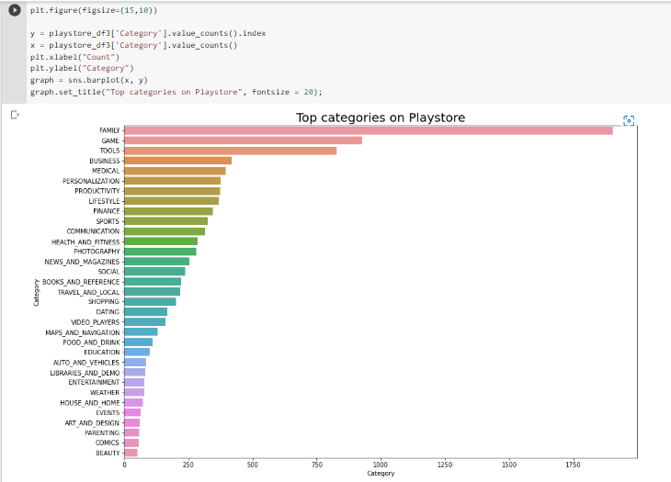
2. Top Categories in Play store
Helpful in identifying the common categories of app
Able to find the least number of apps available category wise
Each categories' contribution
Notes:
For now we are focusing top 10 categories.
Top five categories are Family, Game, Tools, Business, Medical.
This graph is 1. Helpful in identifying the common categories of app.
2. Able to find the least number of apps available category wise.
3. Each categories' contribution.

Slide 33
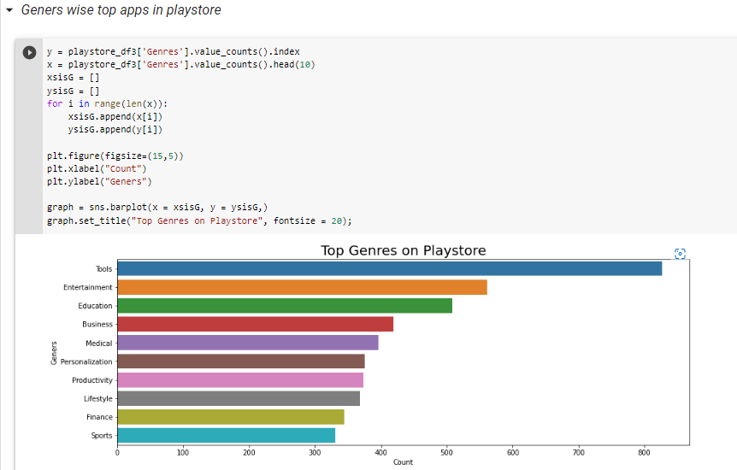
3. Top 10 Genres in Play store
Helpful in identifying top 10 genres in play store
Most Contributed genre
Notes:
Top five genres are Tools, Entertainment, Education, Business and Medical.
This graph is 1. Helpful in identifying top 10 genres in play store.
2. To find most contributed genres.

Slide 34
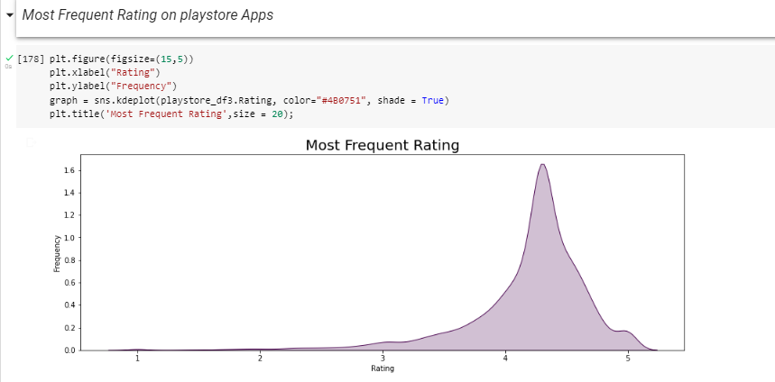
4. Most Frequent Rating on play store Apps
Most app have received rating of approx 4.3
Notes:
Plot histogram for most frequent rating on play store app.
From our research, we found that the average volume of ratings across all app categories is between 4-4.5.
The histogram plot is skewed to the left indicating that the majority of the apps are highly rated with only a few exceptions in the low-rated apps

Slide 35
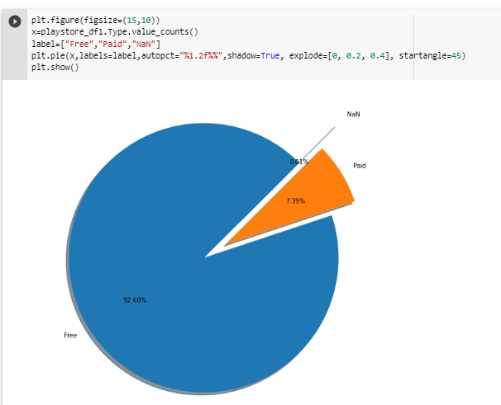
5.Paid and Free Apps Ratio Across play store
Nan value in type column are 0.01%
Free apps in playstore are 92.60%
Paid apps in playstore are 7.39%
Notes:
Near about 93% of apps are free.
And 7% of apps are paid.

Slide 36
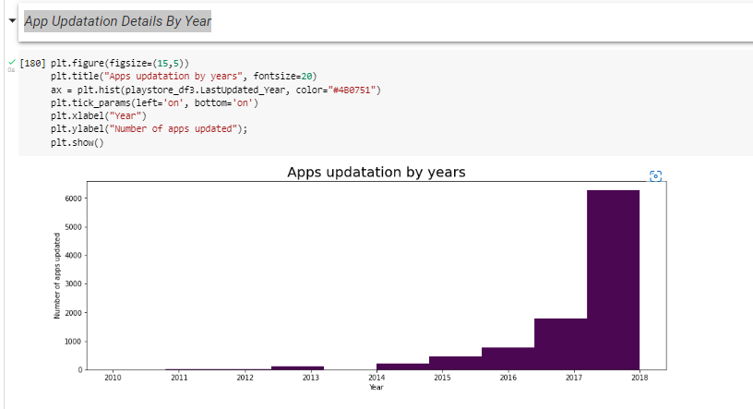
6.App Update Details ‘By Year’
1.Very wide range of app updated in play store during 2017-18
Notes:
During 2017-18 more number of apps are updated.
And from graph we can say it is increasing graph because apps updating rate is increases per year.

Slide 37
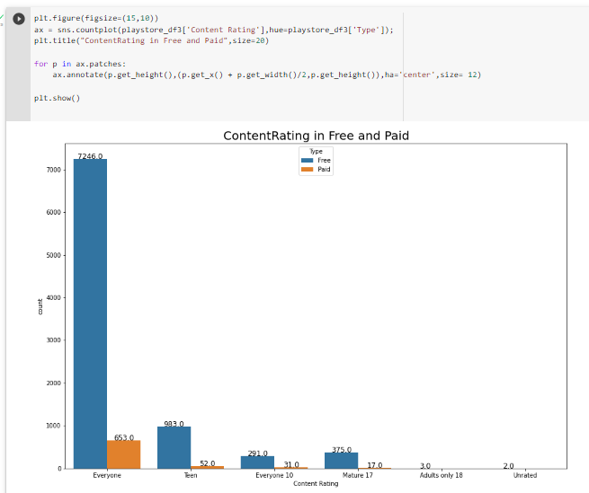
7. Age Wise Free & Paid Apps User’s Detail
After ‘Everyone’ , ‘Teen’ are the max no. of user of the paid and free apps
Notes:
Bar chart for age wise free and paid apps userd detail.
After ‘Everyone’ , ‘Teen’ are the max no. of user of the paid and free apps
For everyone users use 7246 free apps and 653 paid apps.

Slide 38
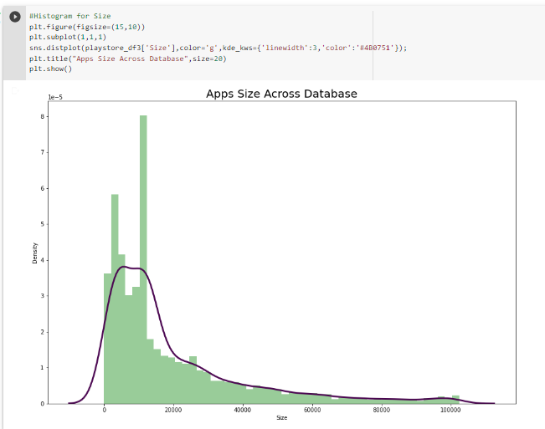
8. Apps Size Across Database
0-20MB size apps are most in play store
Notes:
From the above histogram, it can be concluded that maximum number of applications present in the dataset are of small size.
0-20MB size apps are most in play store.

Slide 39
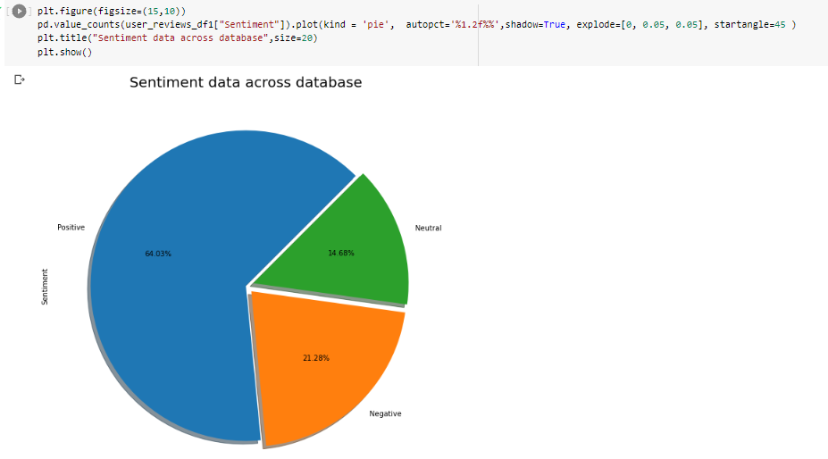
9. Sentiment Data Across the All Reviews
64.03 % of Positive sentiments
21.28% of Negative sentiments
14.68% neutral sentiments
Notes:
sentiments give us an idea about the emotions of the users whether it's positive, negative or neutral
As is clear from the pie charts there are 63.03 % of Positive sentiments,
21.28% of Negative sentiments and
14.68% neutral sentiments

Slide 40
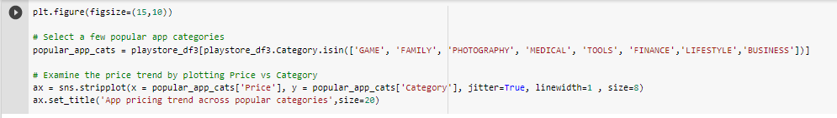
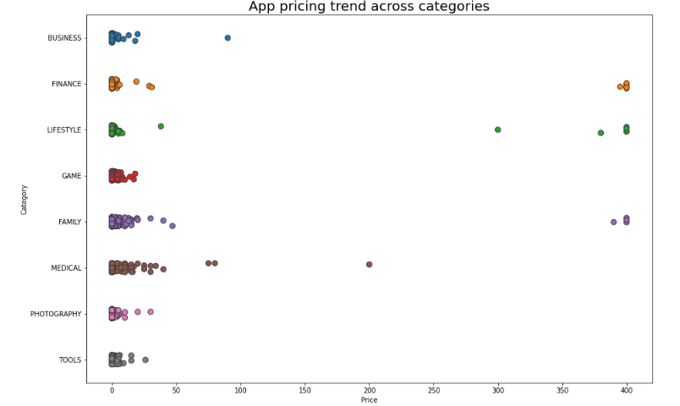
10. App Pricing Trend Across Popular Categories
Notes:
Here we can see most of the paid apps has a price range under $100.
Most of medical and family categorical apps are paid.

Slide 41
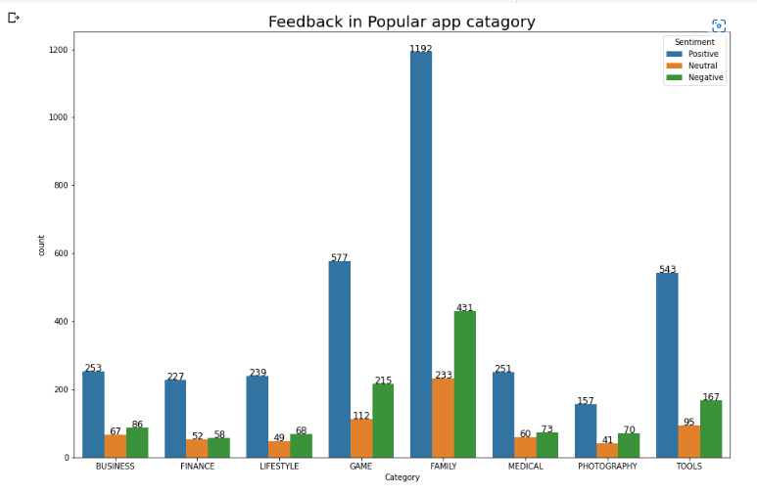
11. Feedback in Popular app catagory
1. Family category is most popular category and has more positive feedback.
2. After family category game and tool category has more positive feedback
Notes:
Family category is most popular category and has more positive feedback.
After family category game and tool category has more positive feedback.

Slide 42
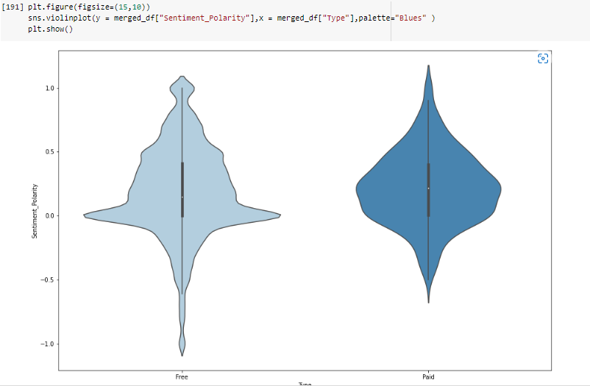
12. Sentiment_Polarity relation with paid and Free App
1. Sentiment polarity for free and paid app is between –1 to 1.
2. From our research, we found that the average volume of sentiment around 0.0 for free and paid apps.
Notes:
Violin plot for sentiment polarity relation with paid and free app.
Sentiment polarity for free and paid app is between –1 to 1.
From our research, we found that the average volume of sentiment around 0.0 for free and paid apps.

Slide 43
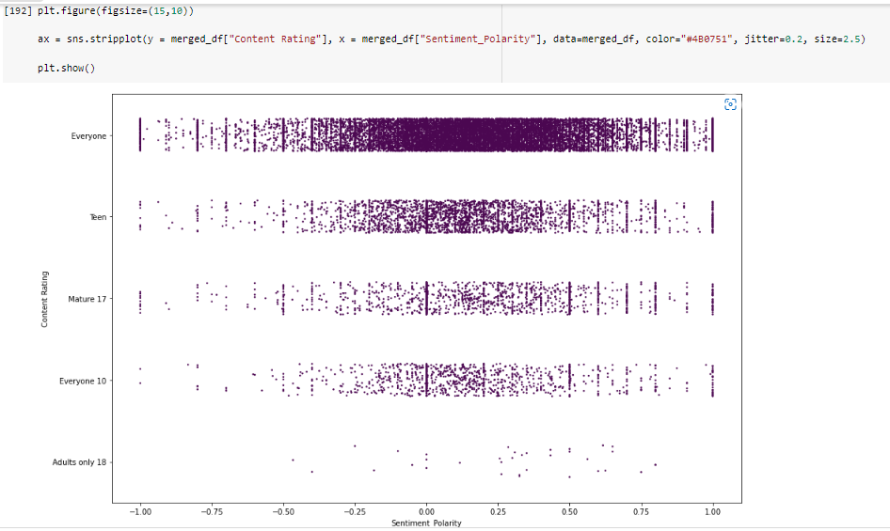
13. Content Rating Relation with Sentiment Polarity
1. From our research, we found that the average volume of sentiment across all content rating is between -0.50 to 0.75
2. For adult density of sentiment polarity is very low and for everyone density of sentiment polarity is high.
Notes:
From our research, we found that the average volume of sentiment across all content rating is between -0.50 to 0.75
For adult density of sentiment polarity is very low and for everyone density of sentiment polarity is high.

Slide 44
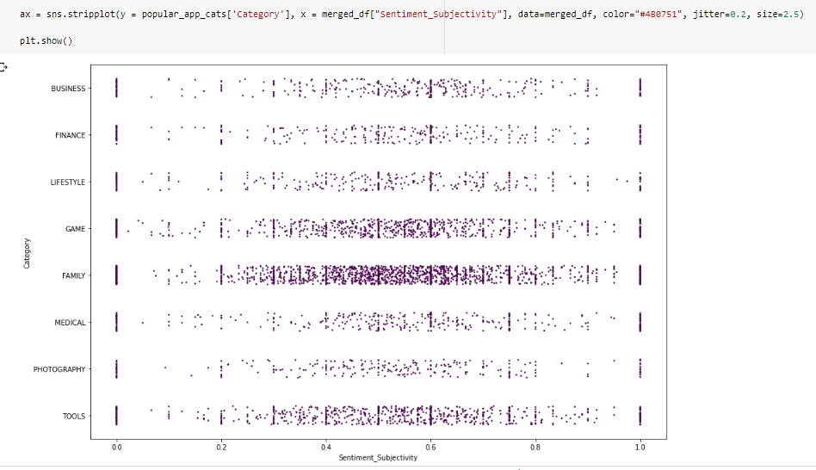
14.Categories Relation with Sentiment_Subjectivity
1. The density of sentiment subjectivity for family, games and tools category is high.
2. Sentiment subjectivity for all categories is between 0 to 1
Notes:
The density of sentiment subjectivity for family, games and tools category is high.
Sentiment subjectivity for all categories is between 0 to 1.

Slide 45
Conclusions
Most Apps(~65%) are compatible with android version 4.0 or above.
Family , Games and Tools are the top 3 categories of in the given dataset.
Tools, Entertainment, Education related genres have maximum number of apps among all 119 genres.
4.3 rating is the most rating that the apps get .
Free Apps are approx. 93% compared to 7% Paid apps.
Most of the apps (around 6k) were updated in the year 2018.
Content Rating ‘Everyone’ belongs to almost 90% of the Apps followed by the ‘Teens’.
Apps with size range 0-20mb have the highest share.
64% of the apps has positive sentiment.
Most of the paid apps has a price range under $100.
Notes:
This is the end of our story. In this, we have seen
How visualizations make anything interesting.
There's a hell lot of competition in Android market.
Thank you.

